Slide 1

Computational Physics
Name : Sumit Ghosh Roll No.: 20201222
Assignment – II
Year - 2023

Slide 2

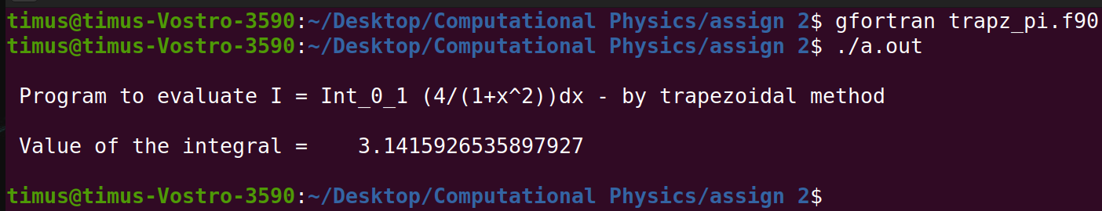
By trapezoidal method calculate
Trapezoidal method, Actual value = π
No. of grid points (n) | Value of the integral | Absolute_error
10 | 3.00000000000000 | 0.141592653589793
100 | 3.13992598890716 | 0.00166666468263443
1000 | 3.14157598692313 | 1.66666666641113E-05
10000 | 3.14159248692312 | 1.66666668910409E-07
100000 | 3.14159265192314 | 1.66665303780178E-09
1000000 | 3.14159265357315 | 1.66404667822917E-11

Slide 3
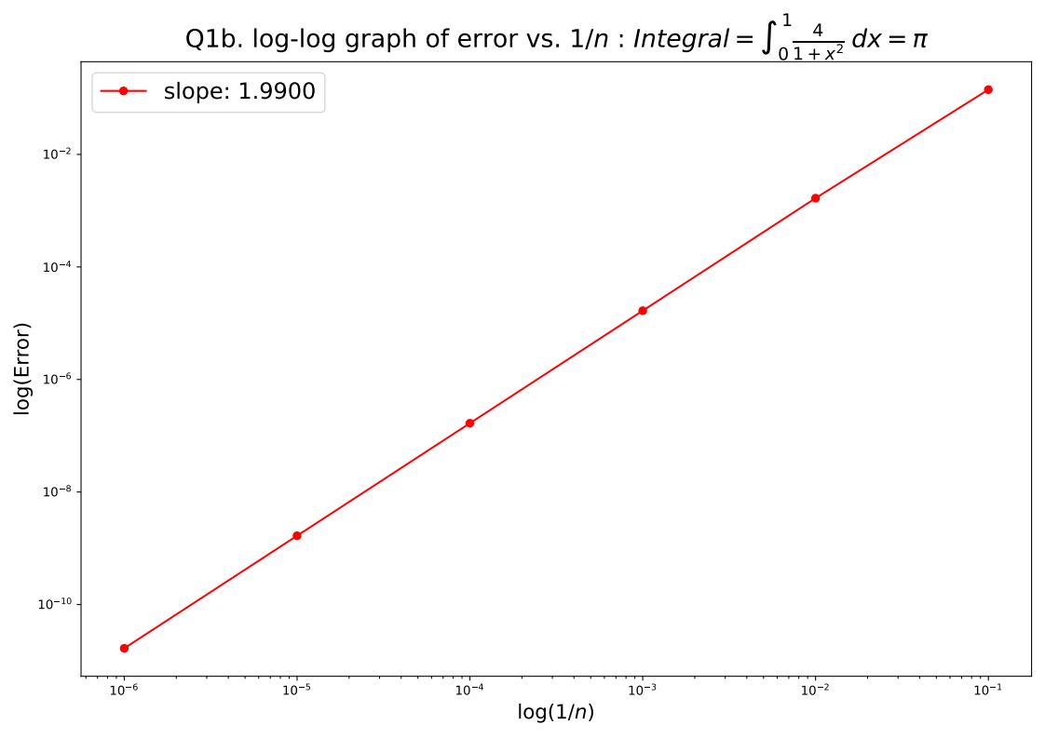

Slide 4
By trapezoidal method integrate Sin(x) within limits 0 to π.
Trapezoidal method, Actual value = 2
dx | Value of the integral | Absolute_error
0.314159265358979 | 1.98352353750945 | 0.0164764624905454
0.0314159265358979 | 1.99983550388744 | 0.000164496112556423
0.00314159265358979 | 1.99999835506566 | 1.64493433763013E-06
0.000314159265358979 | 1.99999998355066 | 1.64493392240672E-08
3.14159265358979E-05 | 1.99999999983548 | 1.64520841394733E-10
3.14159265358979E-06 | 1.99999999999841 | 1.5922818619174E-12

Slide 5
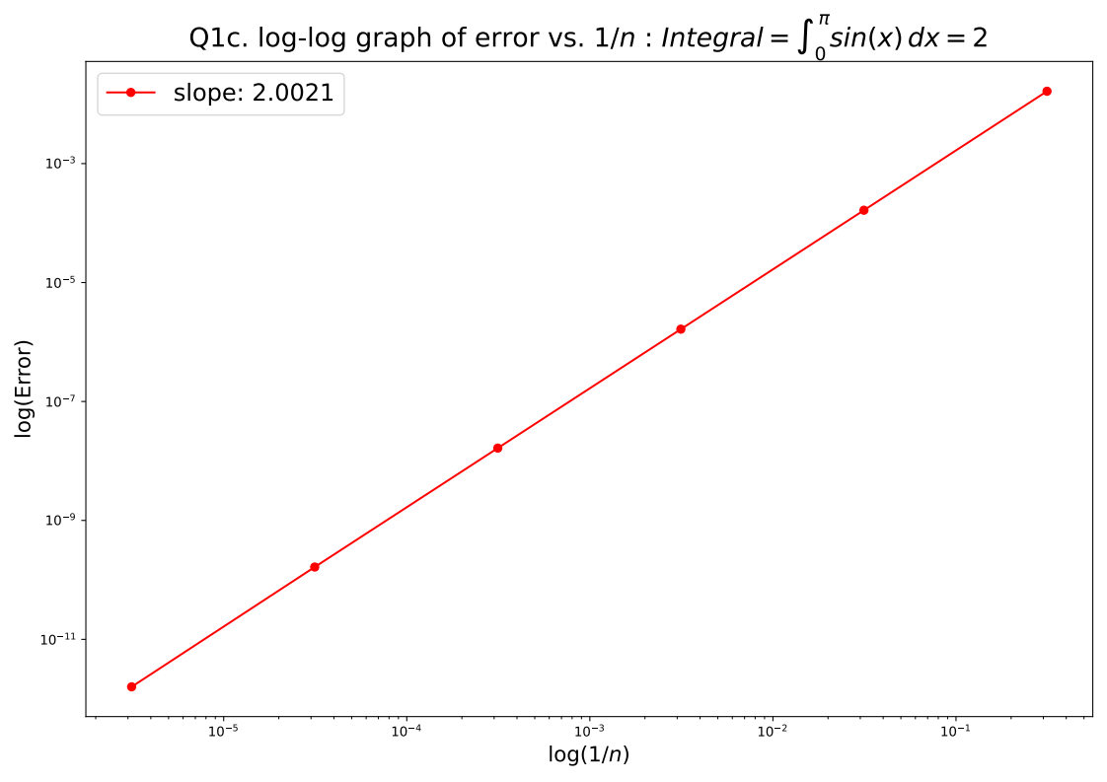

Slide 6

By using trapezoidal mathod we integrate the normalized gaussian function :
Limits -3 to +3
No. of gridpoints (n) | Value of the integral
10 | 0.026591090471628
100 | 0.996530893052922
1000 | 0.99729222948119
10000 | 0.997300124163754
100000 | 0.997300203139005
1000000 | 0.997300203928767
Limits -5 to +5
No. of grid points (n) | Value of the integral
10 | 1.4867195147343E-05
100 | 0.999998506461016
1000 | 0.999999414352764
10000 | 0.999999426572969
100000 | 0.999999426695614
1000000 | 0.999999426696839

Slide 7
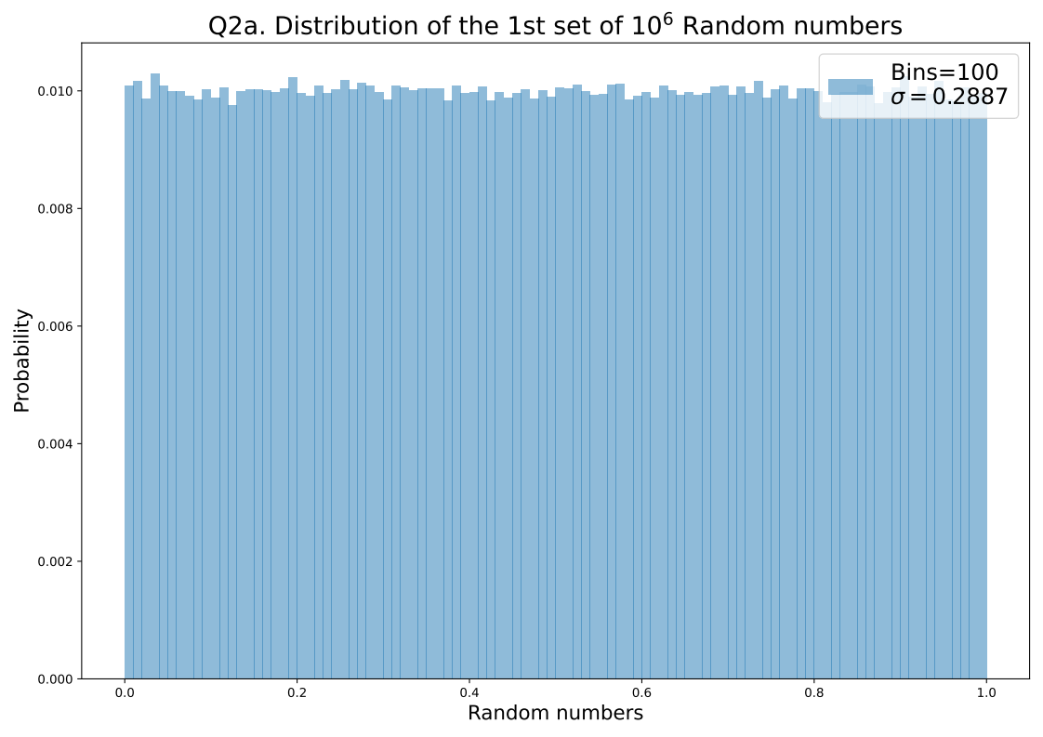

Slide 8
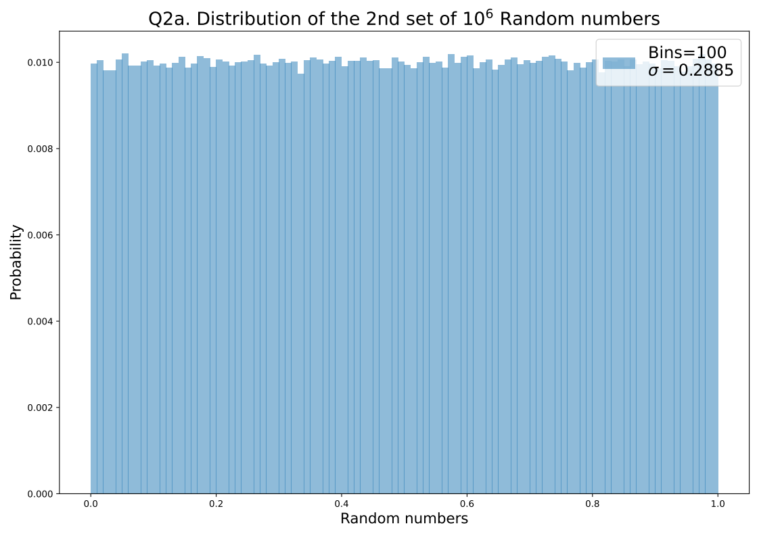

Slide 9
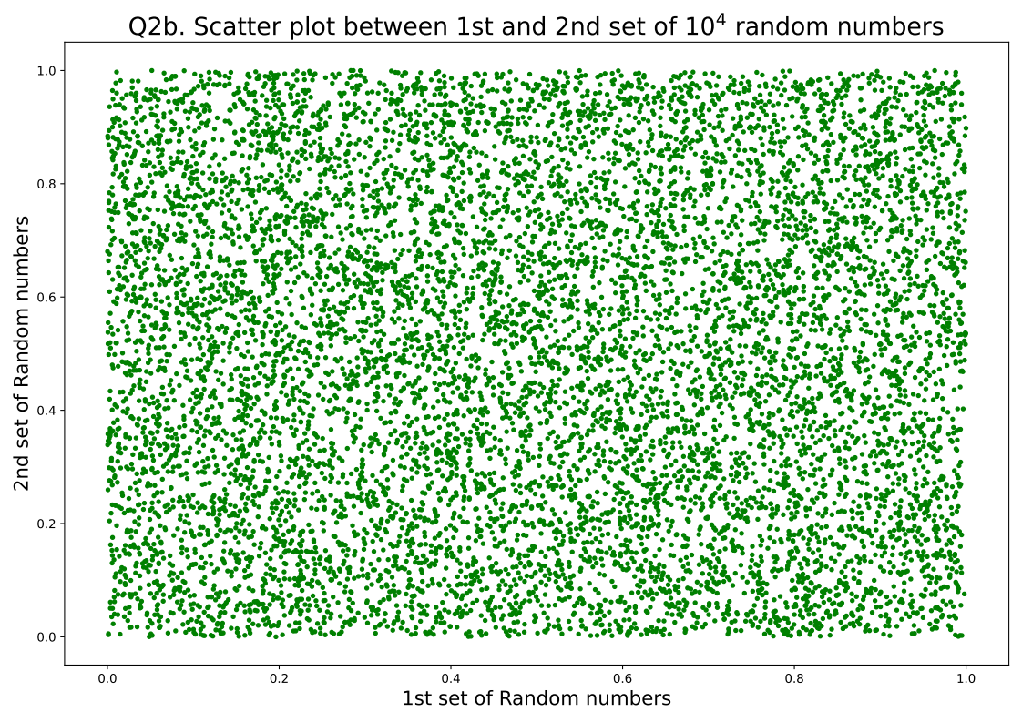

Slide 10
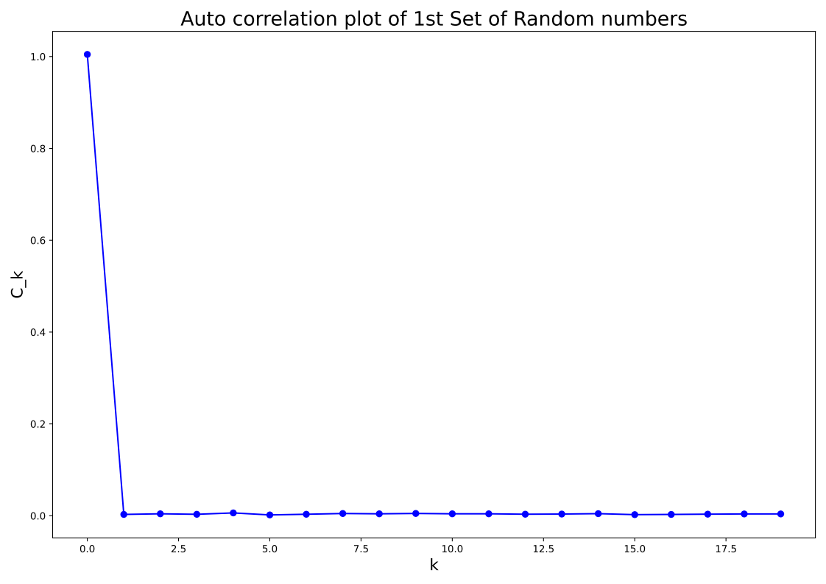

Slide 11
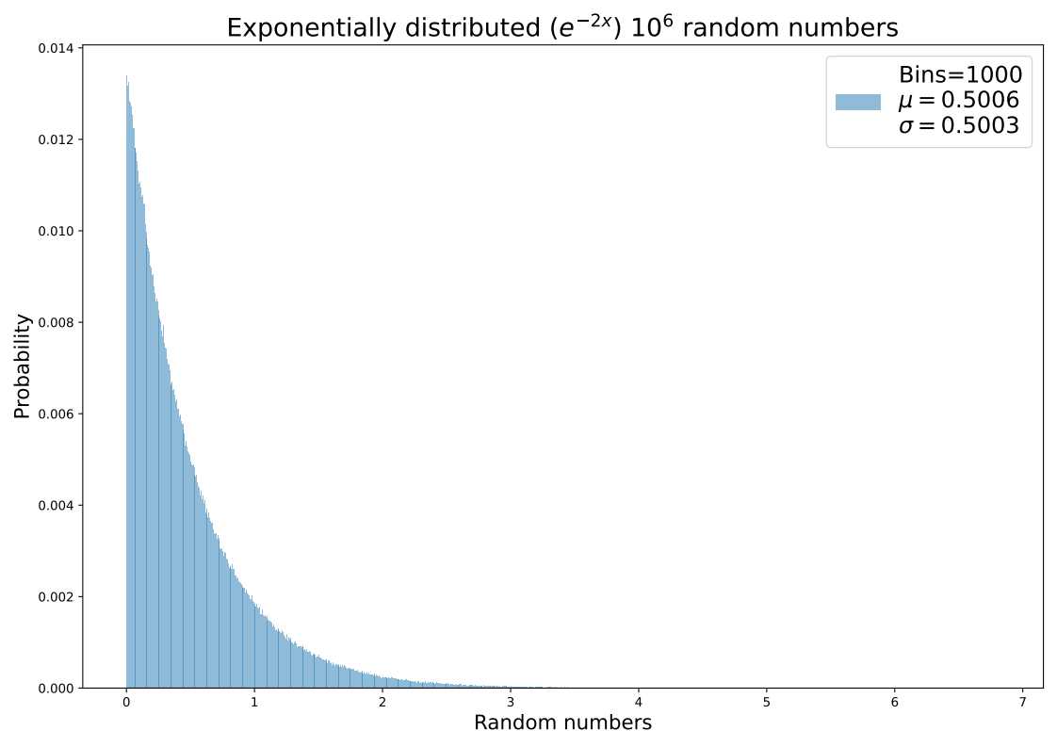

Slide 12
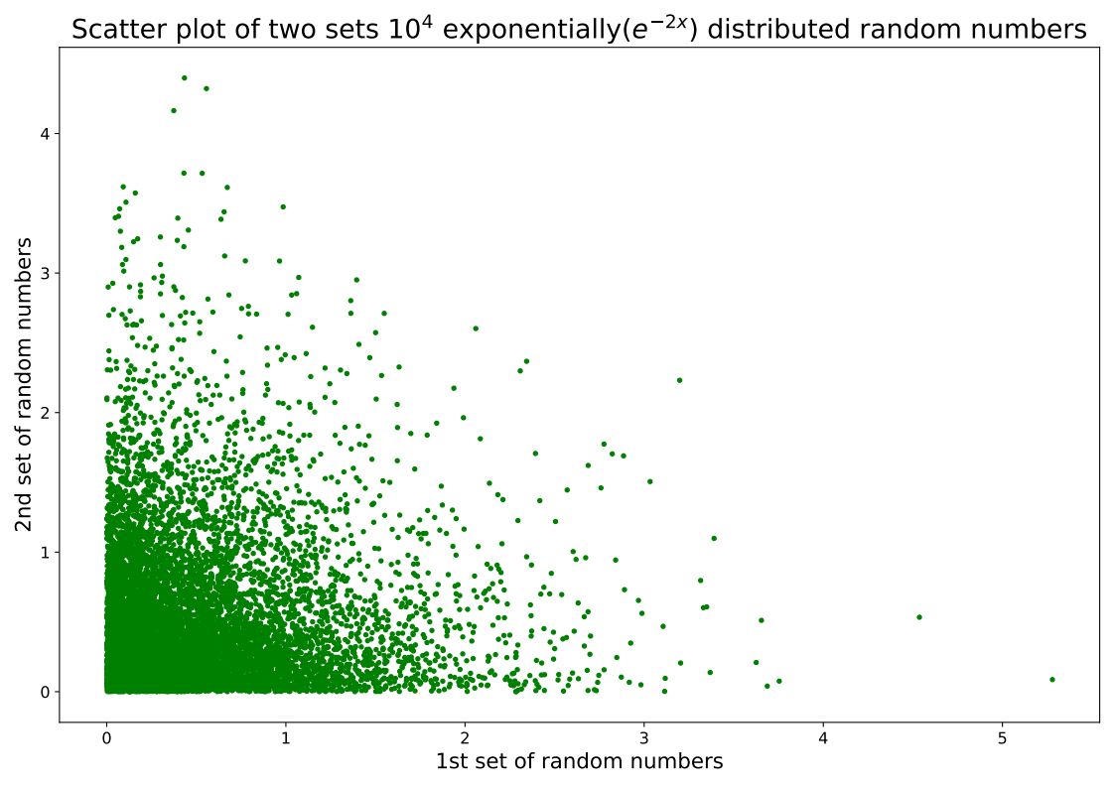

Slide 13
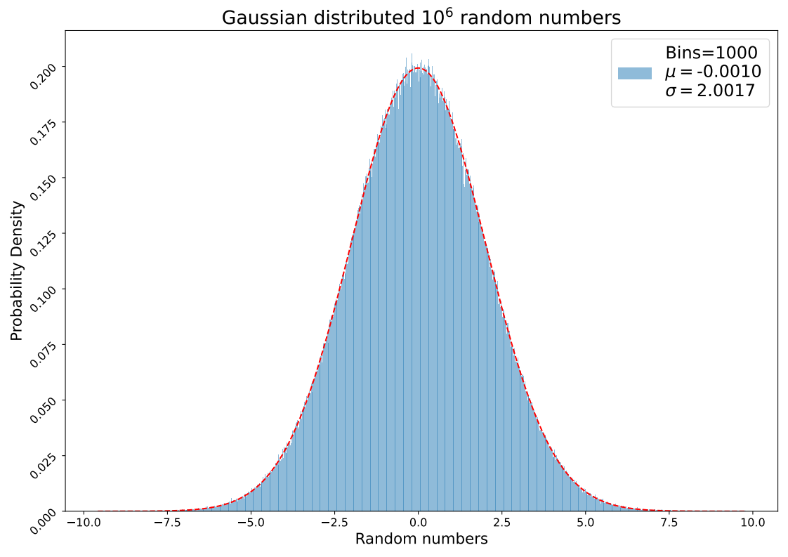

Slide 14
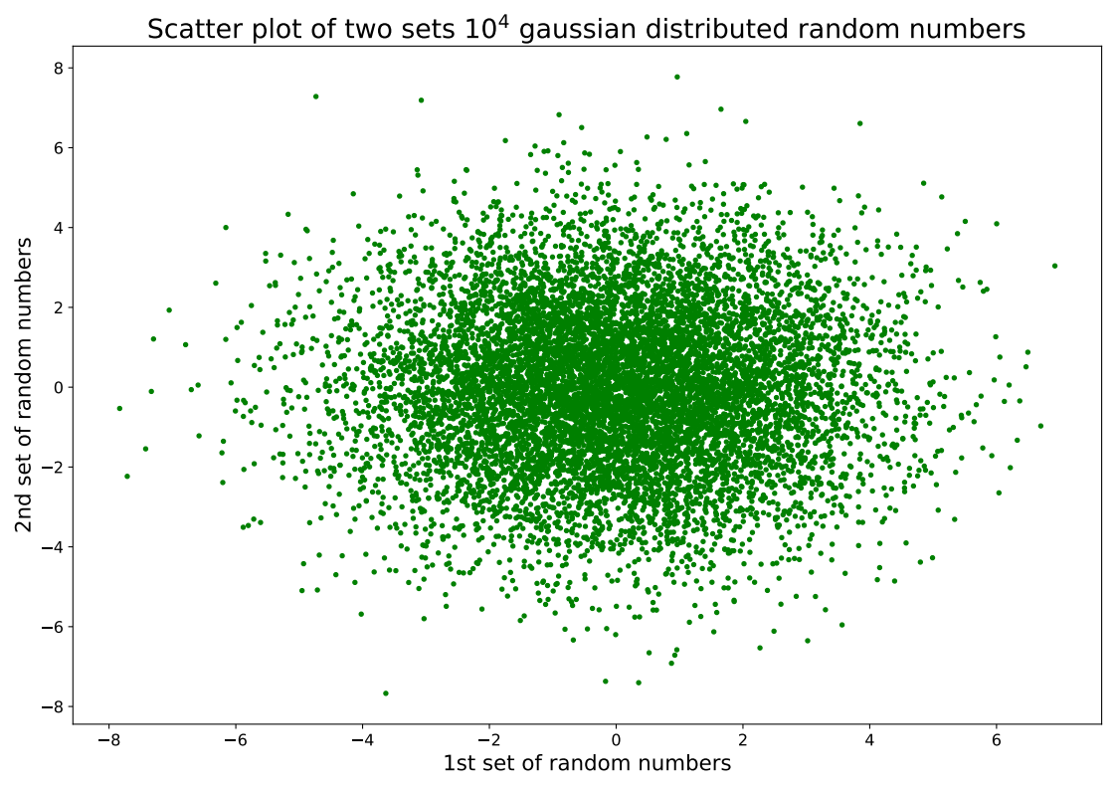

Slide 15
Using Monte Carlo Brute Force method
No. of iterations (n) | Value of the integral | Standard deviation
10 | 9.02253710014757E-07 | 8.5522350007934E-07
100 | 7.84976850971433E-06 | 7.80992654121664E-06
1000 | 1.61975432572342 | 1.36019921262025
10000 | 5.12100379571561 | 2.22879424933112
100000 | 5.89670067916585 | 1.29868842683667
1000000 | 10.8418267299382 | 0.981605377194319
10000000 | 10.7817305203506 | 0.362123705348325
100000000 | 11.0877487072685 | 0.116524406634294
Using Monte Carlo importance sampling method
No. of iterations (n) | Value of the integral | Standard deviation
10 | 11.069117498493 | 2.46316962021154
100 | 11.3767831158921 | 0.734888003541454
1000 | 11.0686458897031 | 0.259392925244426
10000 | 10.8941871973983 | 0.0806824124643543
100000 | 10.9798037967382 | 0.0255159419141156
1000000 | 10.9710404351189 | 0.0080550620720396
10000000 | 10.959848601345 | 0.00254577821592316
100000000 | 10.9610982518212 | 0.000805196403344519

Slide 16
